Slide 1
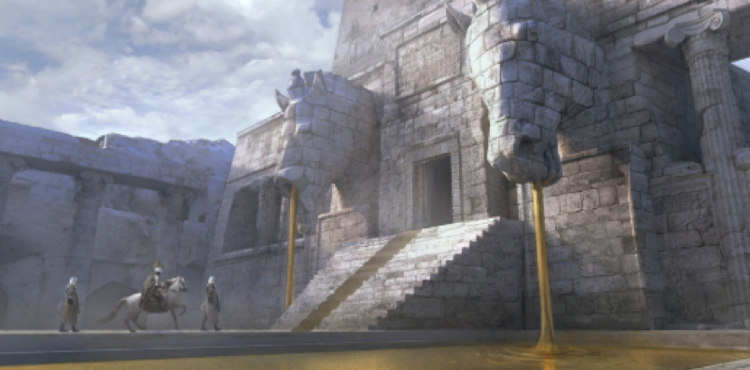
Workshop 1

Slide 2
Project
Students to choose an activity in a playground and create the assets needed to complete the environment for a character (supplied) using the equipment I.e. swings, see-saw, roundabout etc
The final animation will include all playground equipment created and being used by the character as chosen by the student.

Slide 3
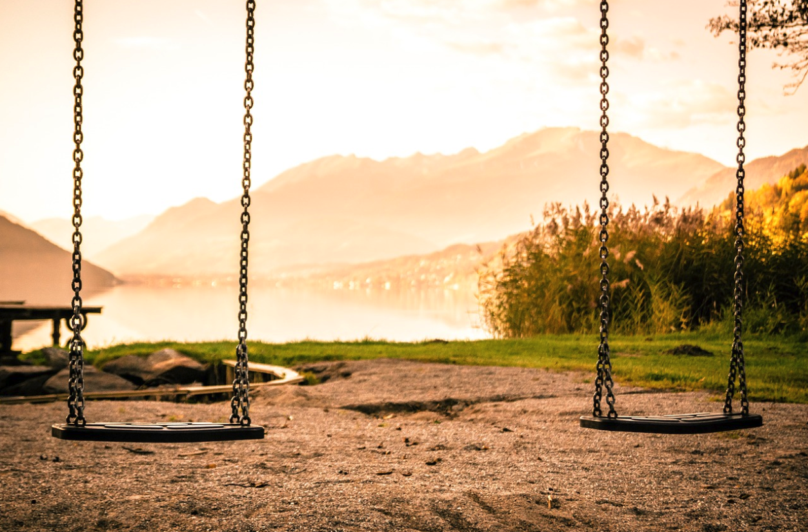
Reference Images - Assets
Search the internet for a sample of images that you can use to model your chosen activity on.

Slide 4
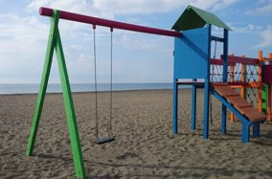
Reference Images - Environment
Later on we will look at building the environment your playground will be in but again the focus is on animation of the assets within the playground so you don't have to spend too much time on this
You may like to think about the style of your animation and the colour theme as you go though I.e. cartooney or woodland or seaside...

Slide 5
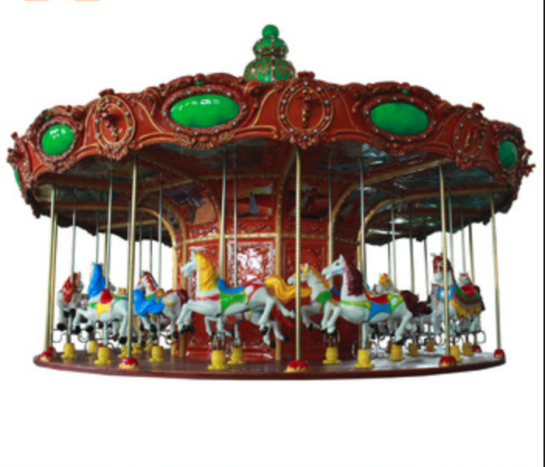
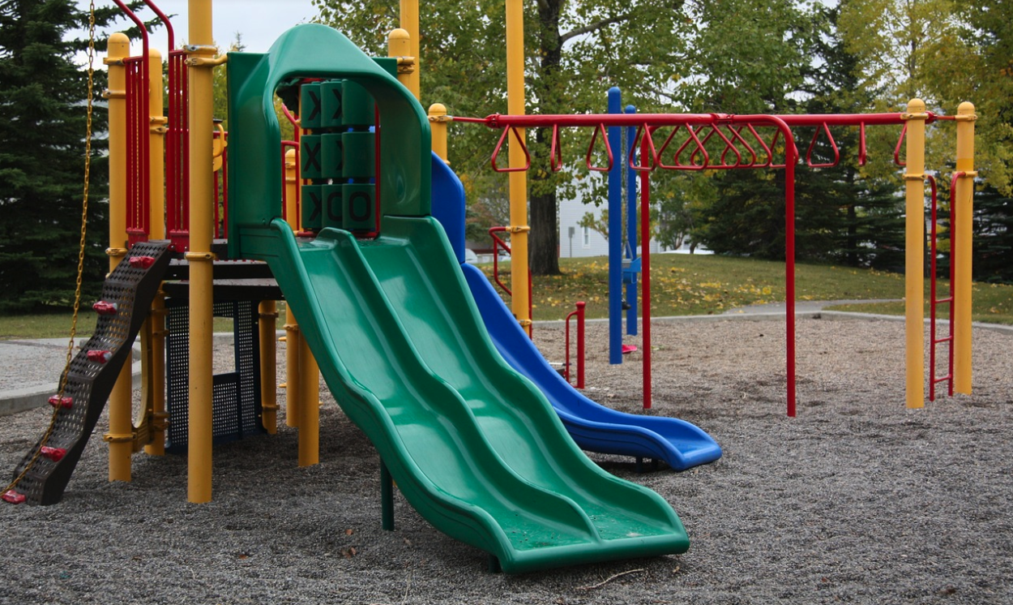
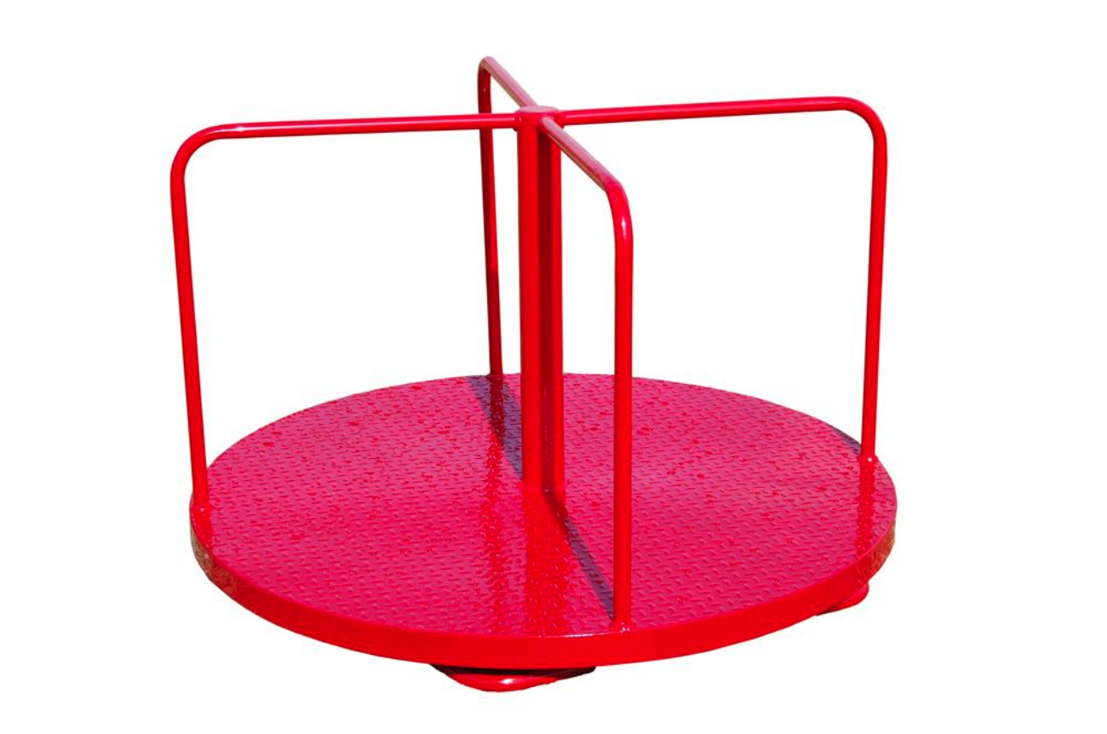
Start simple
While this short course is about animation, having an awareness of assets and environments is a necessary step to understanding what is important when animating 3D objects

Slide 6
Reference Images
Add your reference images here:

Slide 7
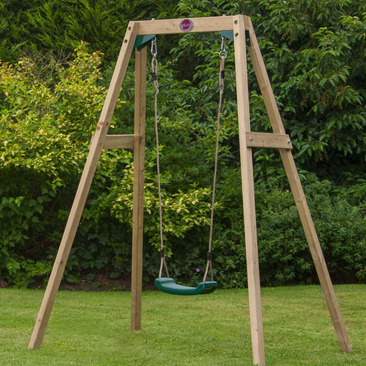
Asset #1 - Swing
Lets look at building a basic single swing, much like the one below to get started.

